Slide 1
Workflow
Quality Control (QC)
Determines whether experimental data can be used for BMD calculations
If QC
0-1
Reports dose_response_auc only and exits
2-4
Apply all models and decide the best model
Report all BMDs with the best model

Slide 2
Curious inquiry
“Another topic for discussion is whether our minimum data requirements or curve fitting criteria are too stringent such that we are not calculating curves for many of the endpoints. I think we’ve optimized this in the past, but it was a very manual process. It has to be a more automated process moving forward, so there will be some give and take in that.“

Slide 3
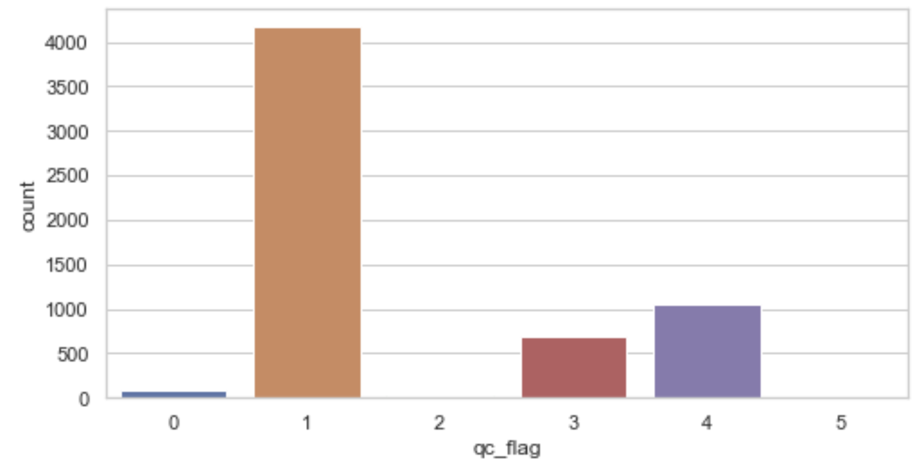
Paritosh’s code systematically validate experimental data (“quality control”) before BMD calculation
With 6,048 cases
(=336 chemicals x 18 endpoints)
0: Not enough dose groups for BMD analysis. BMD analysis not performed
There are fewer than 3 dose groups
1: No trend detected in dose-response data. BMD analysis not performed
If the average response for the first two dose groups is higher than
the average response at the last two dose groups indicating an
overall decreasing trend
Or
If the mean first order differences of responses is 0 indicating a flat response
(determined by a t-test with p-value >= 0.62)
2: Very good dose-response data
p-value for non-flat curve < 0.05
3: Good dose-response data. BMD analysis might be less reliable
p-value for non-flat curve < 0.32
4: Data resolution poor. BMD analysis might be unreliable
p-value for non-flat curve < 0.62
5: Negative correlation detected in dose-response data. Caution advised

Slide 4
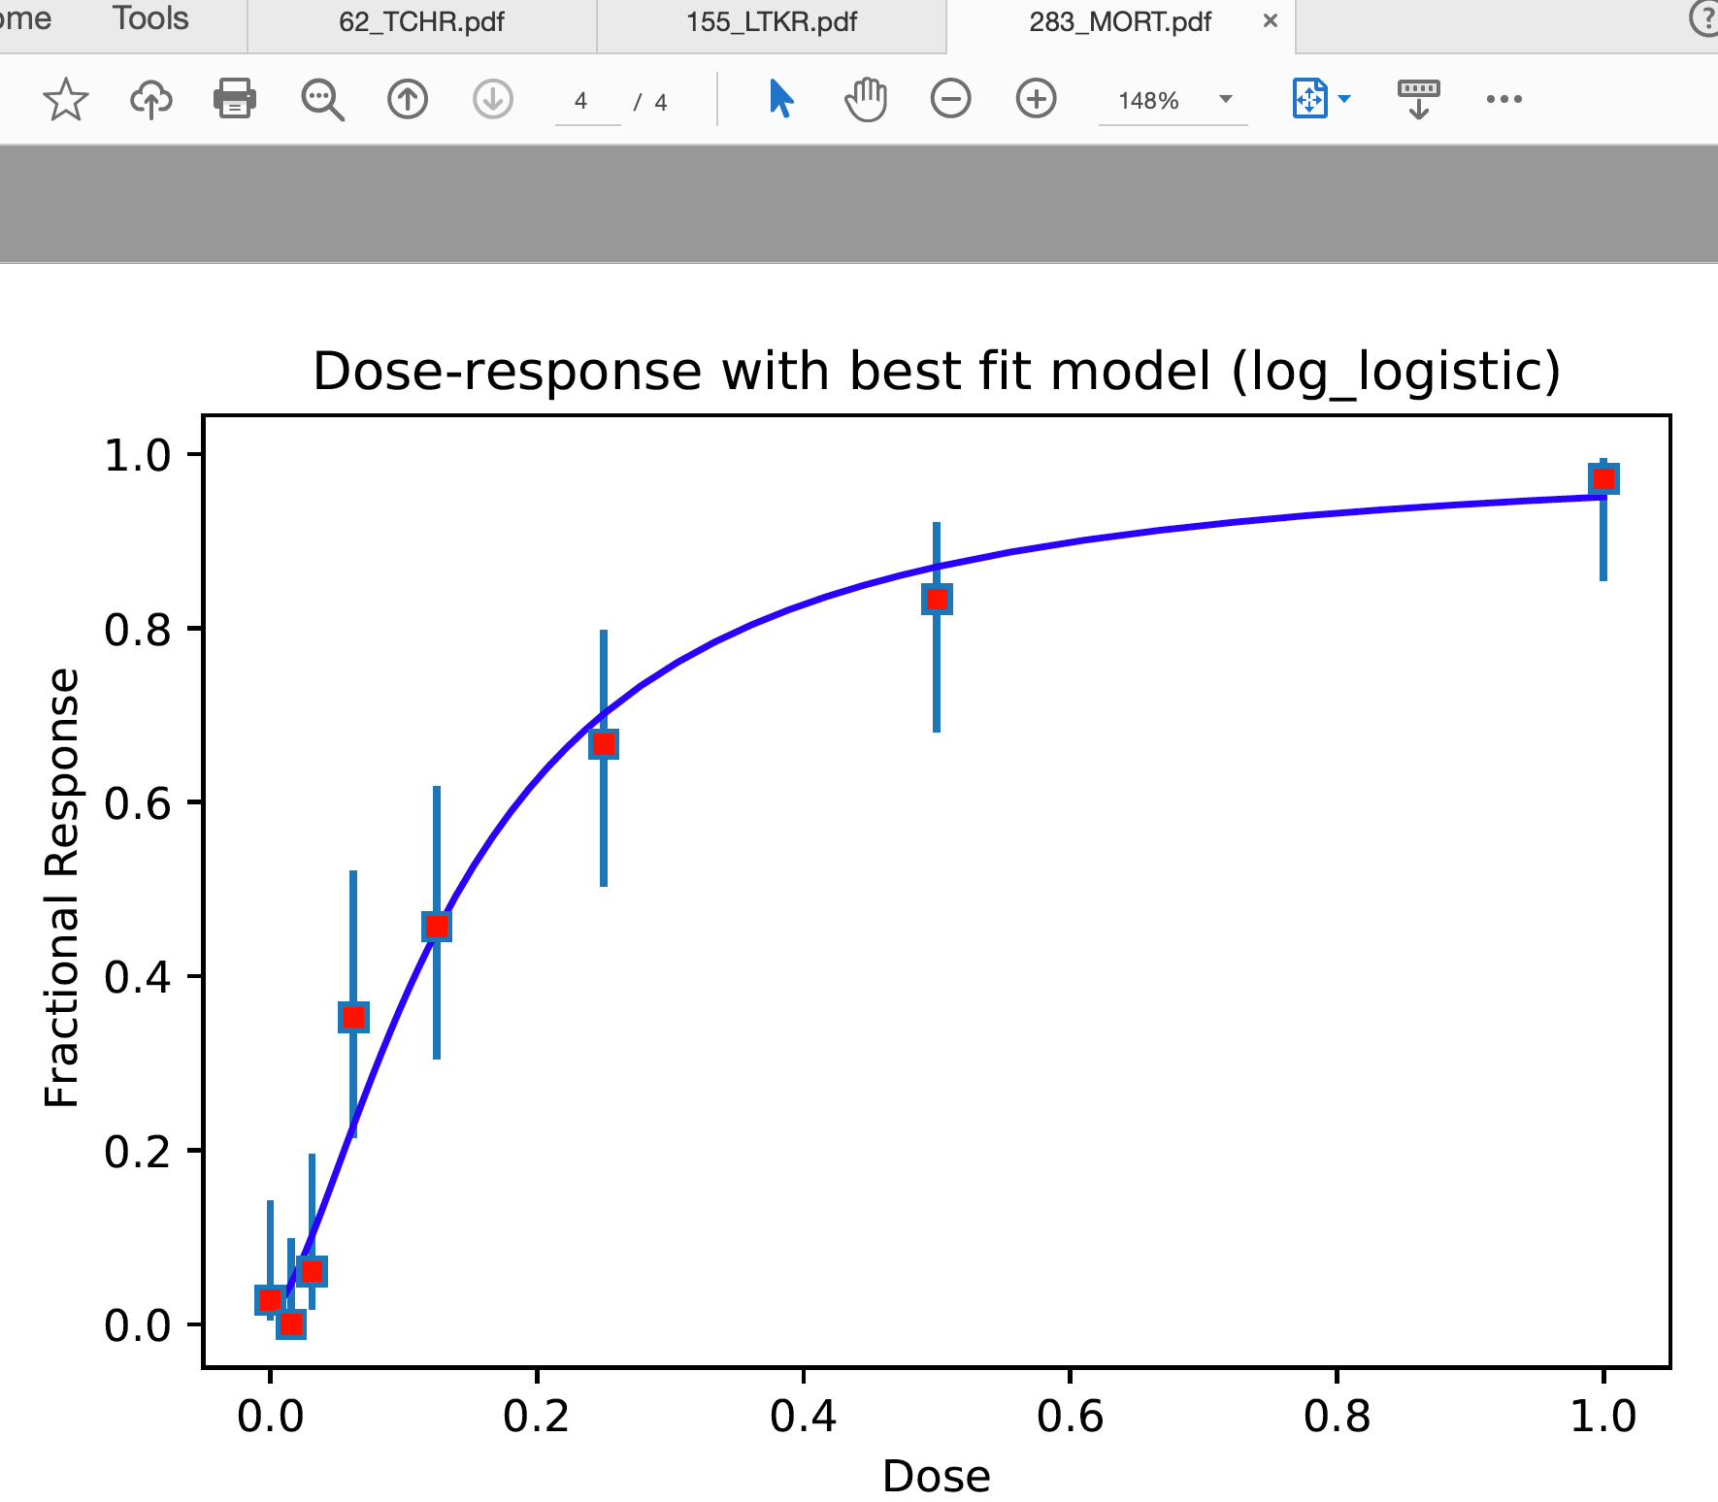
Example
Red dot → response in
dose_response_vals
Blue bar → confidence interval
(low, high)
frac_response = dose_response['num_affect']/dose_response['num_embryos']

Slide 5
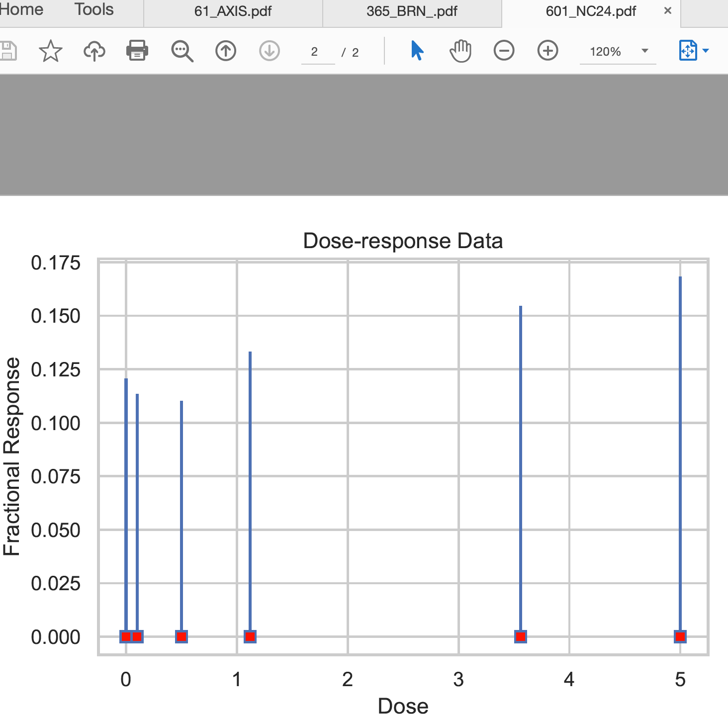
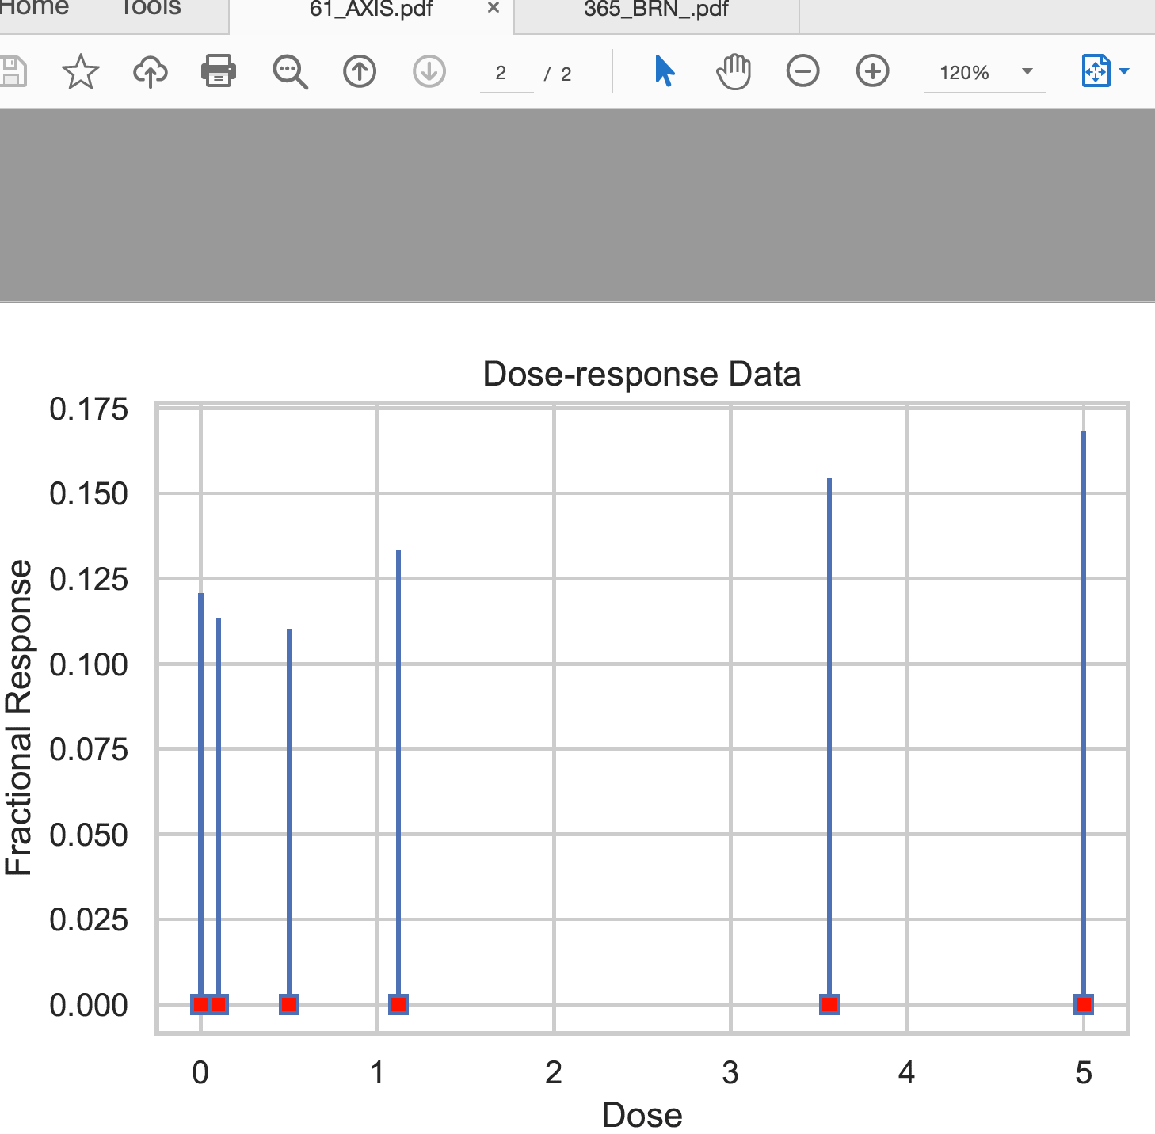
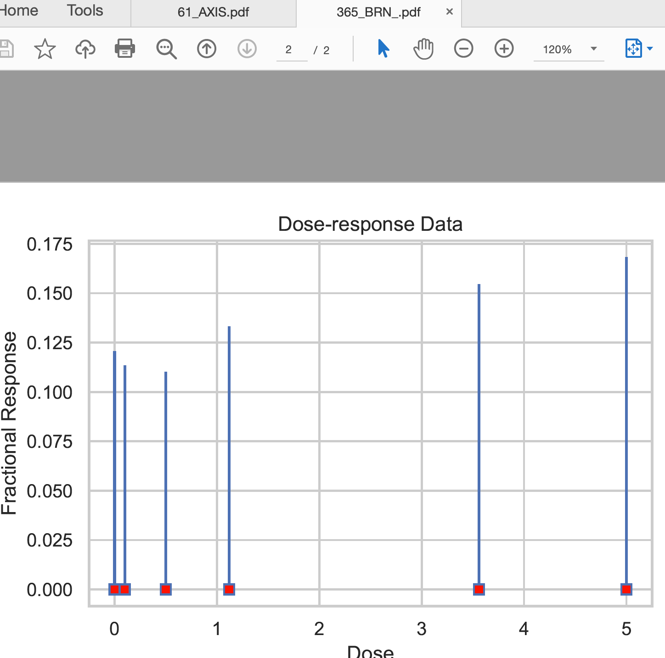
0: Not enough dose groups for BMD analysis.
601 | 13306 | A01 | 601_13306_A01 | 50
601 | 13306 | A02 | 601_13306_A02 | 35.6
601 | 13306 | A03 | 601_13306_A03 | 11.2
601 | 13306 | A04 | 601_13306_A04 | 5 | 0
601 | 13306 | A05 | 601_13306_A05 | 1 | 0
601 | 13306 | A06 | 601_13306_A06 | 0 | 0
Among 6,048 cases (=336 chemicals x 18 endpoints),
93 cases have < 3 dose groups

Slide 6
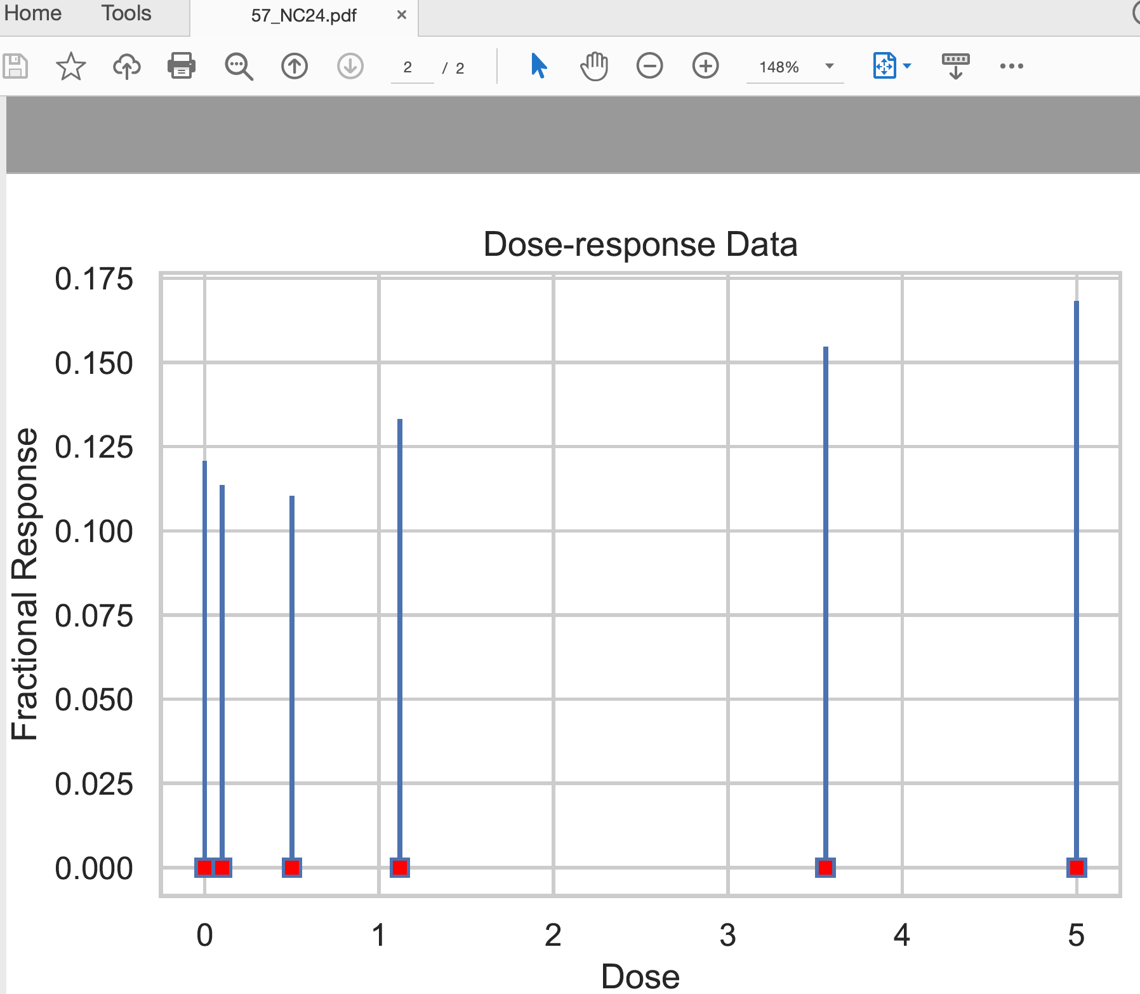
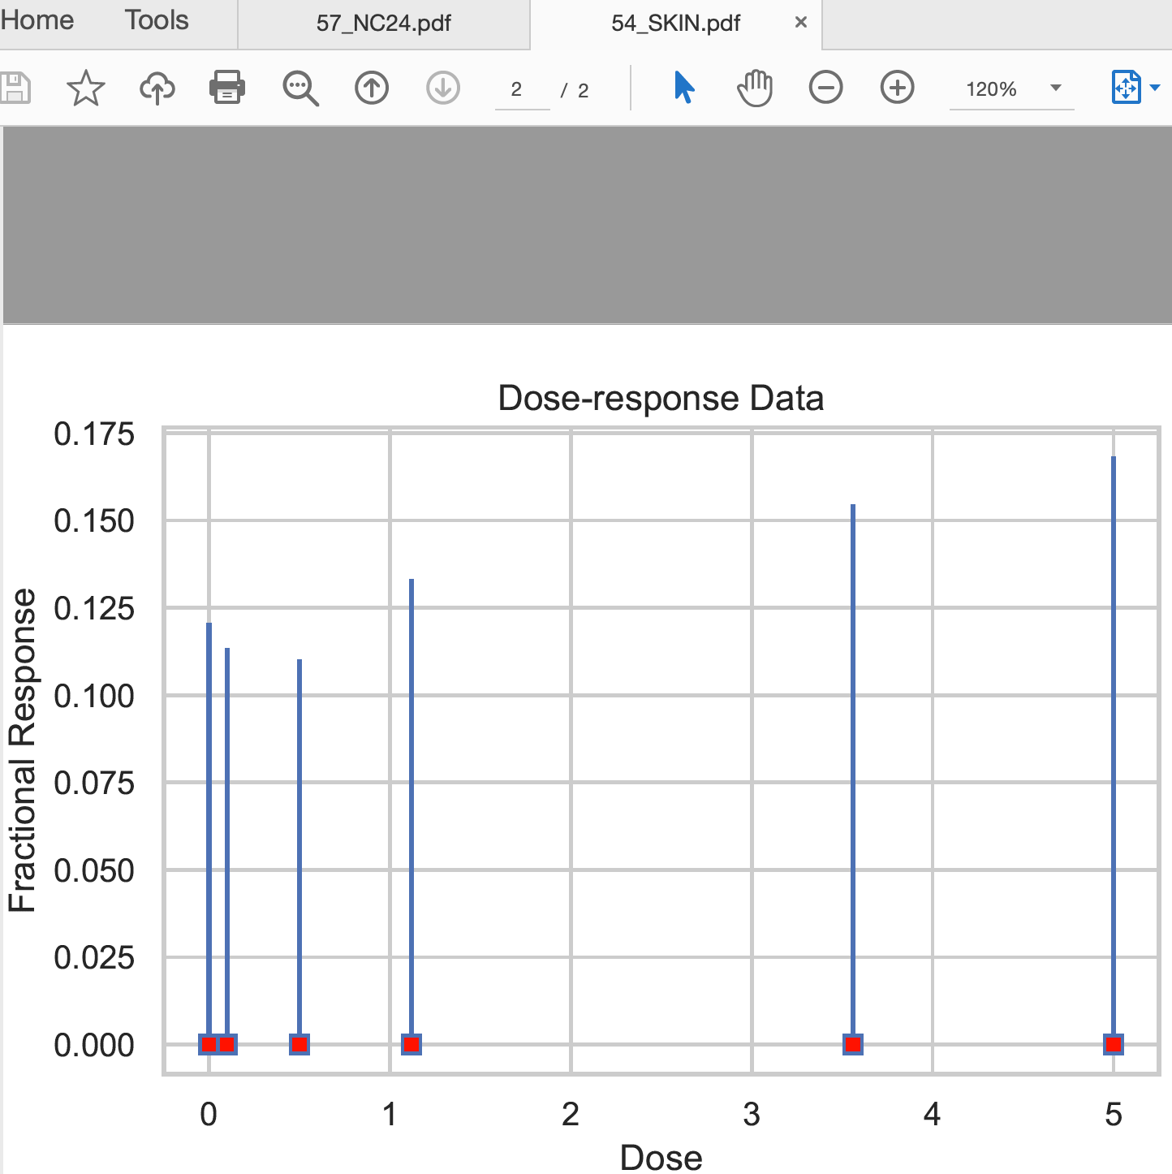
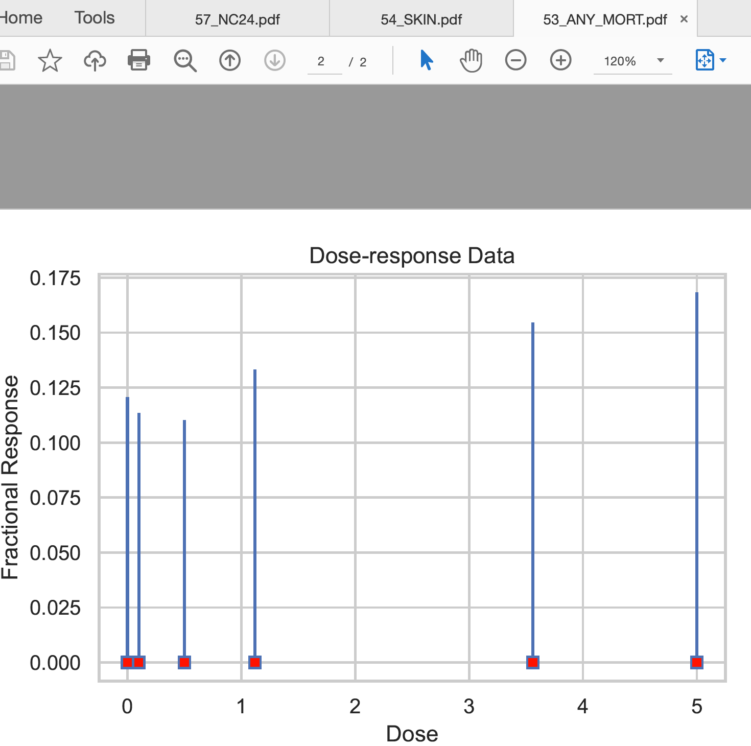
1: No trend detected in dose-response data
Indeed, all 192 values (e.g. wells for
32 repetitive experiments
with 6 concentrations)
have all 0 values (except 3 blanks)

Slide 7
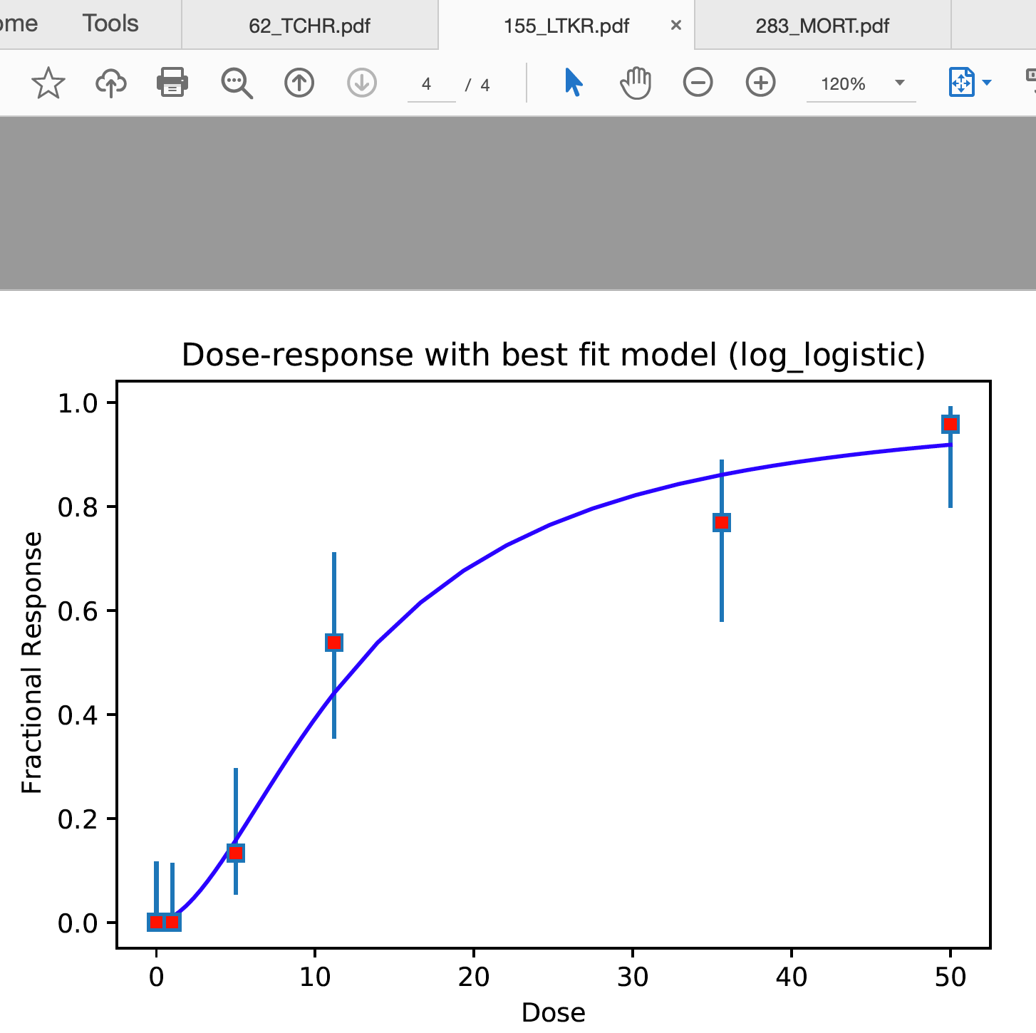
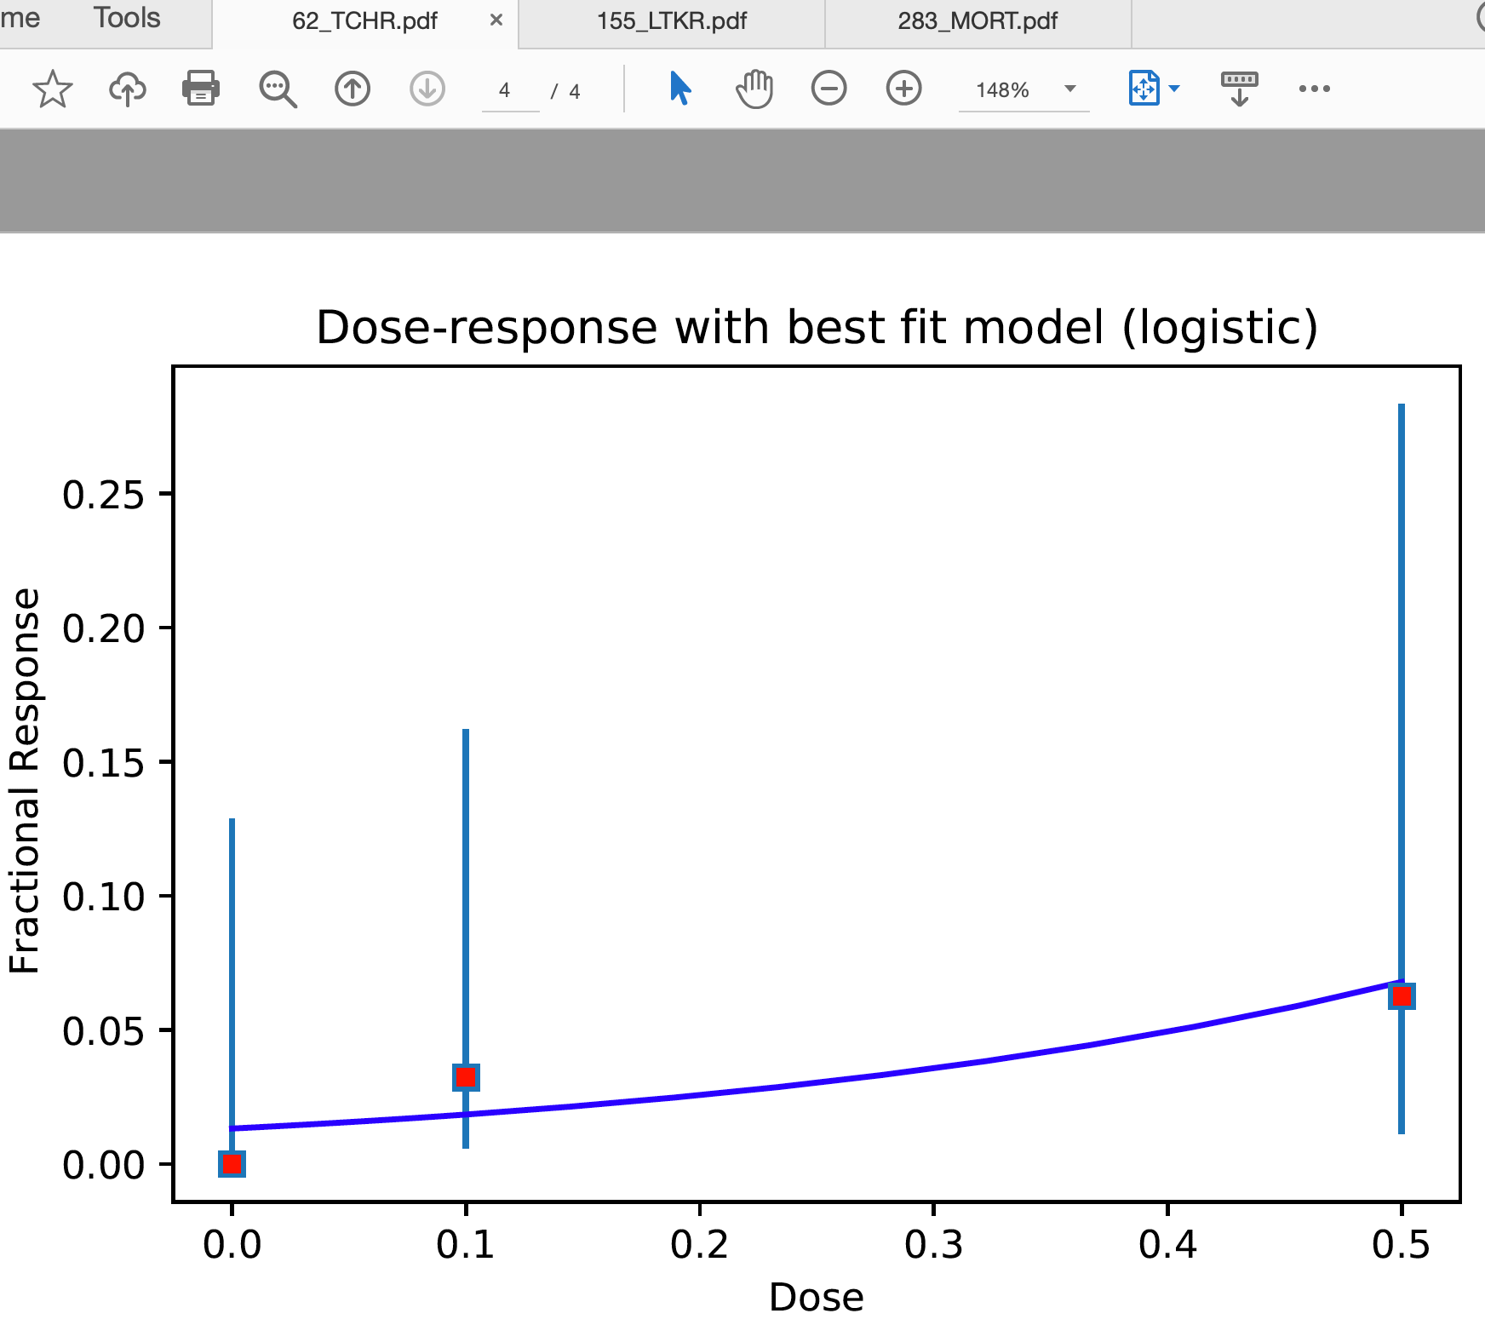
2: Very good dose-response data
Indeed, raw data shows positive correlation
between dose and responses

Slide 8
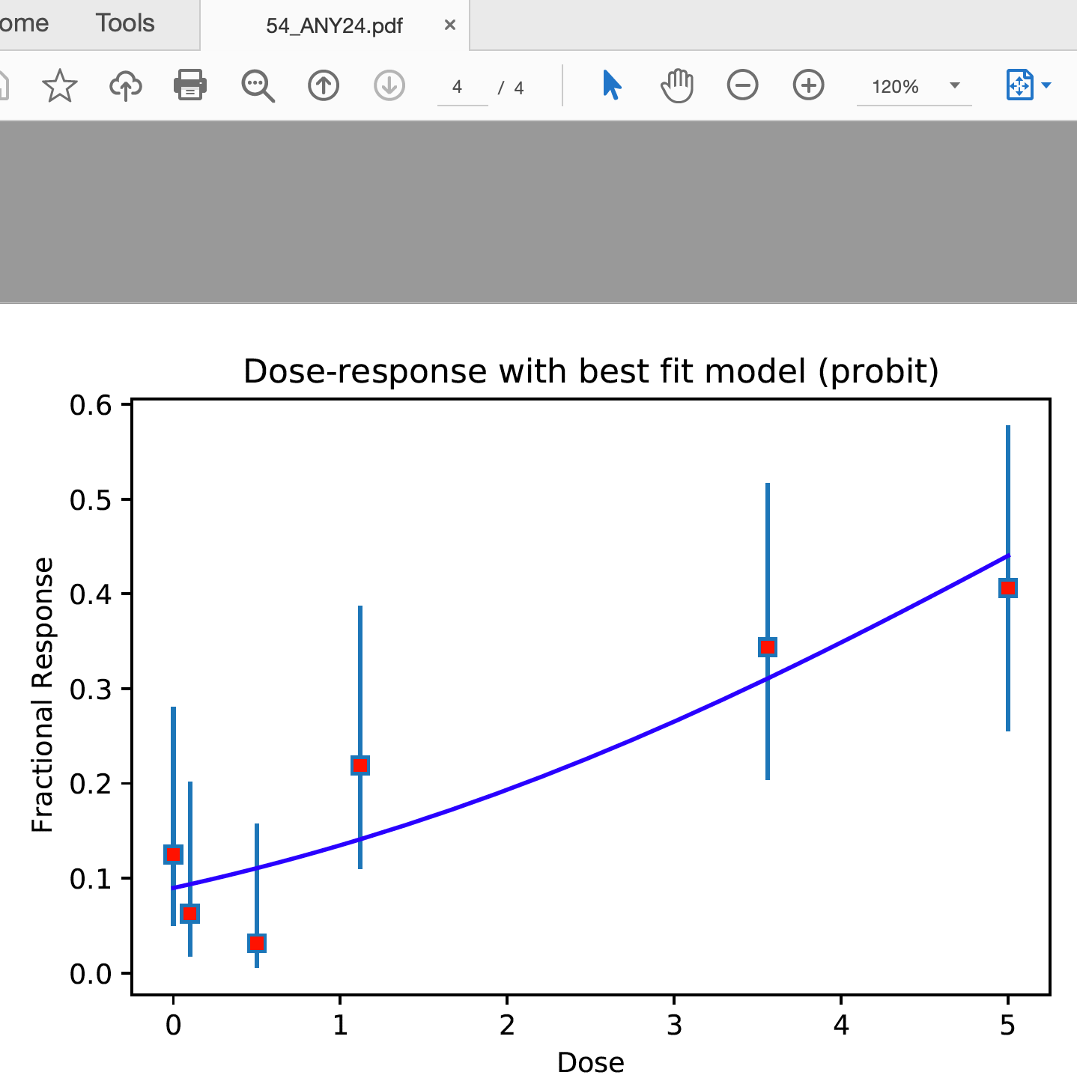
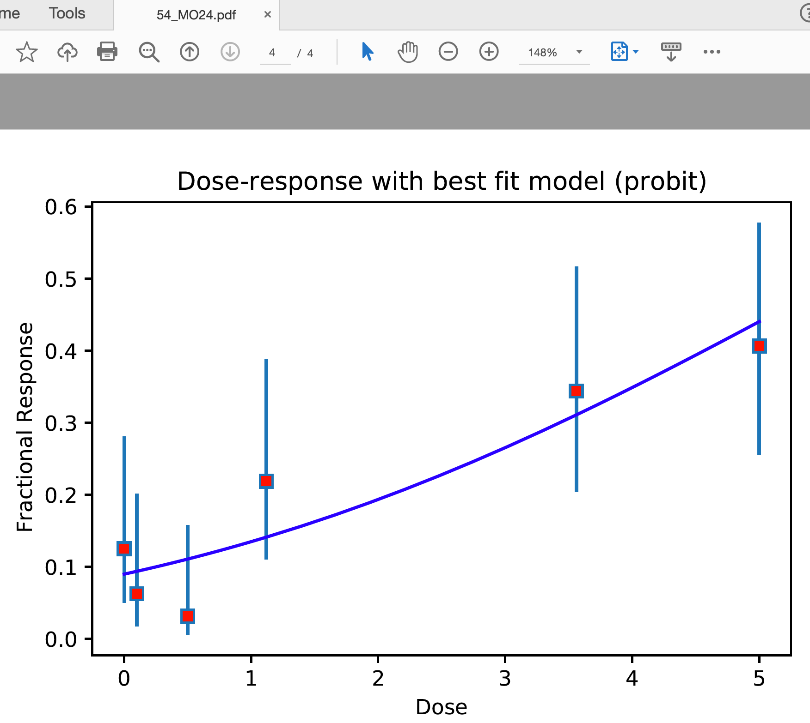
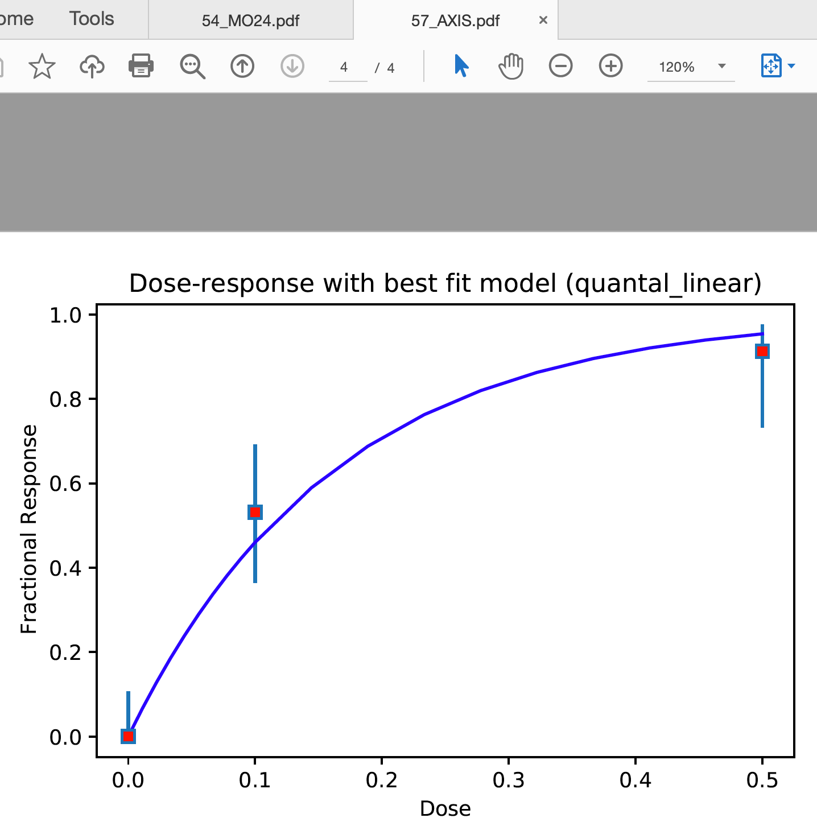
3: Good dose-response data. BMD analysis might be less reliable

Slide 9
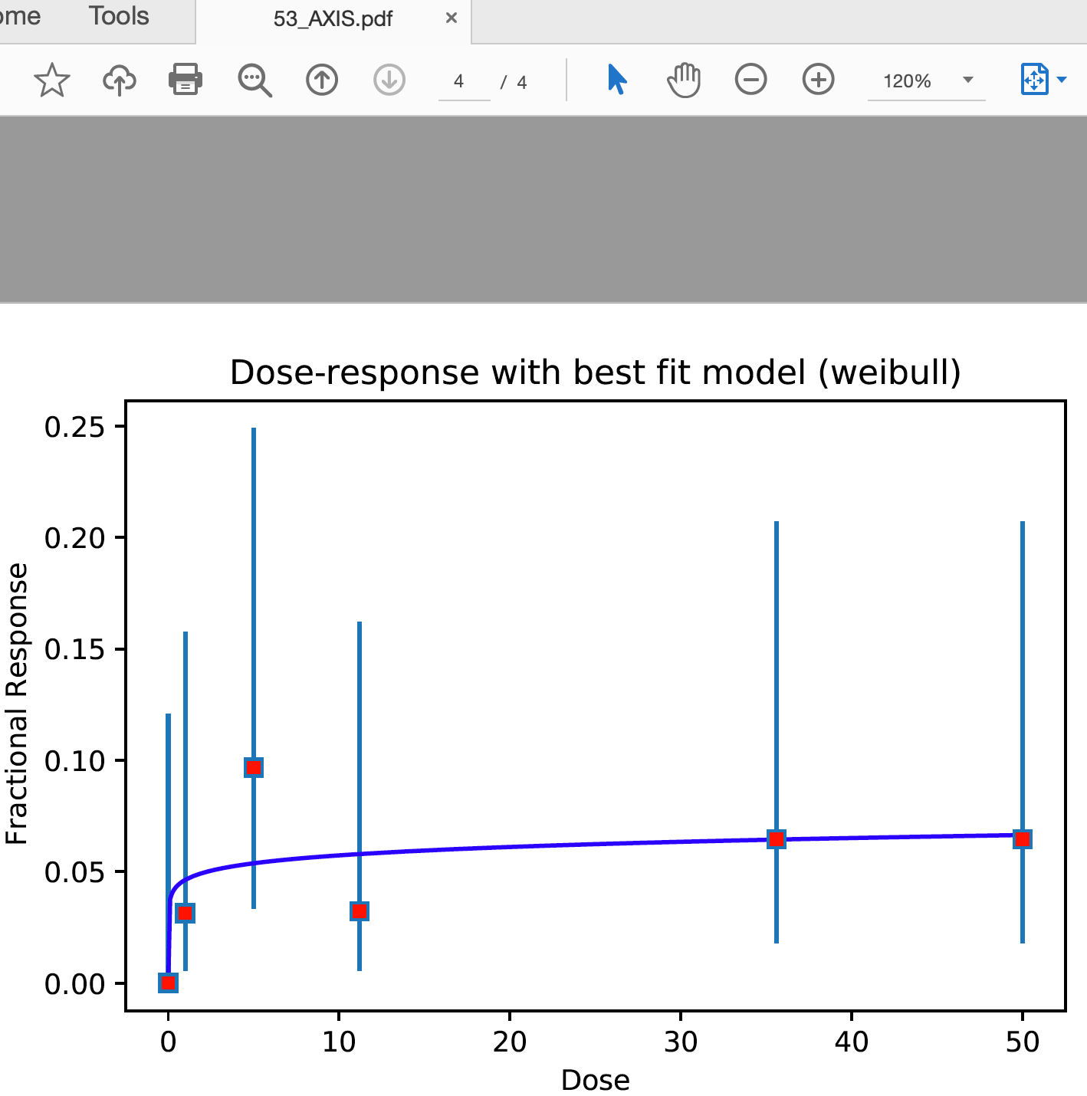
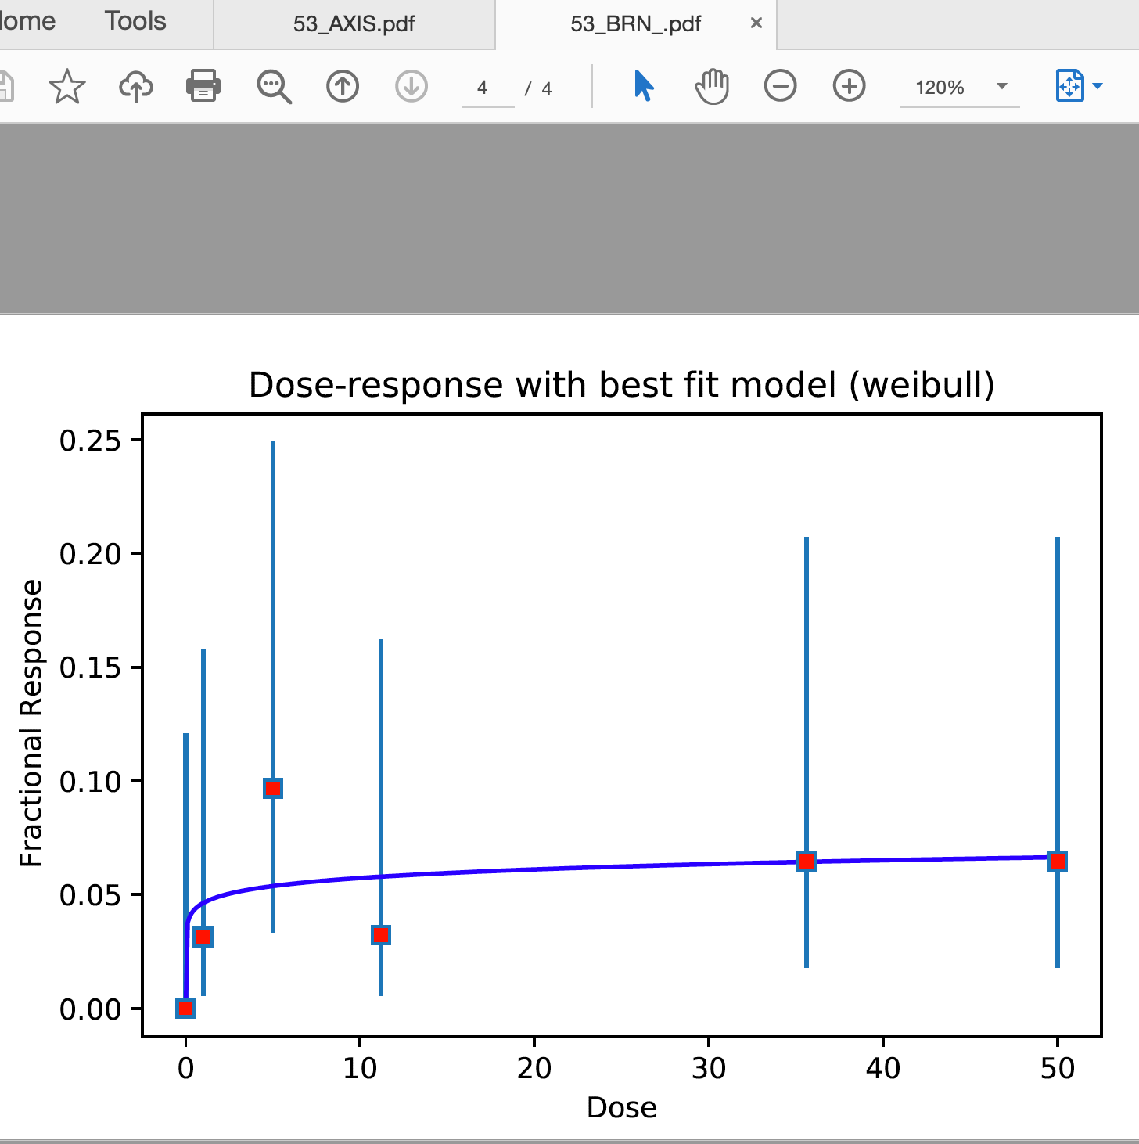
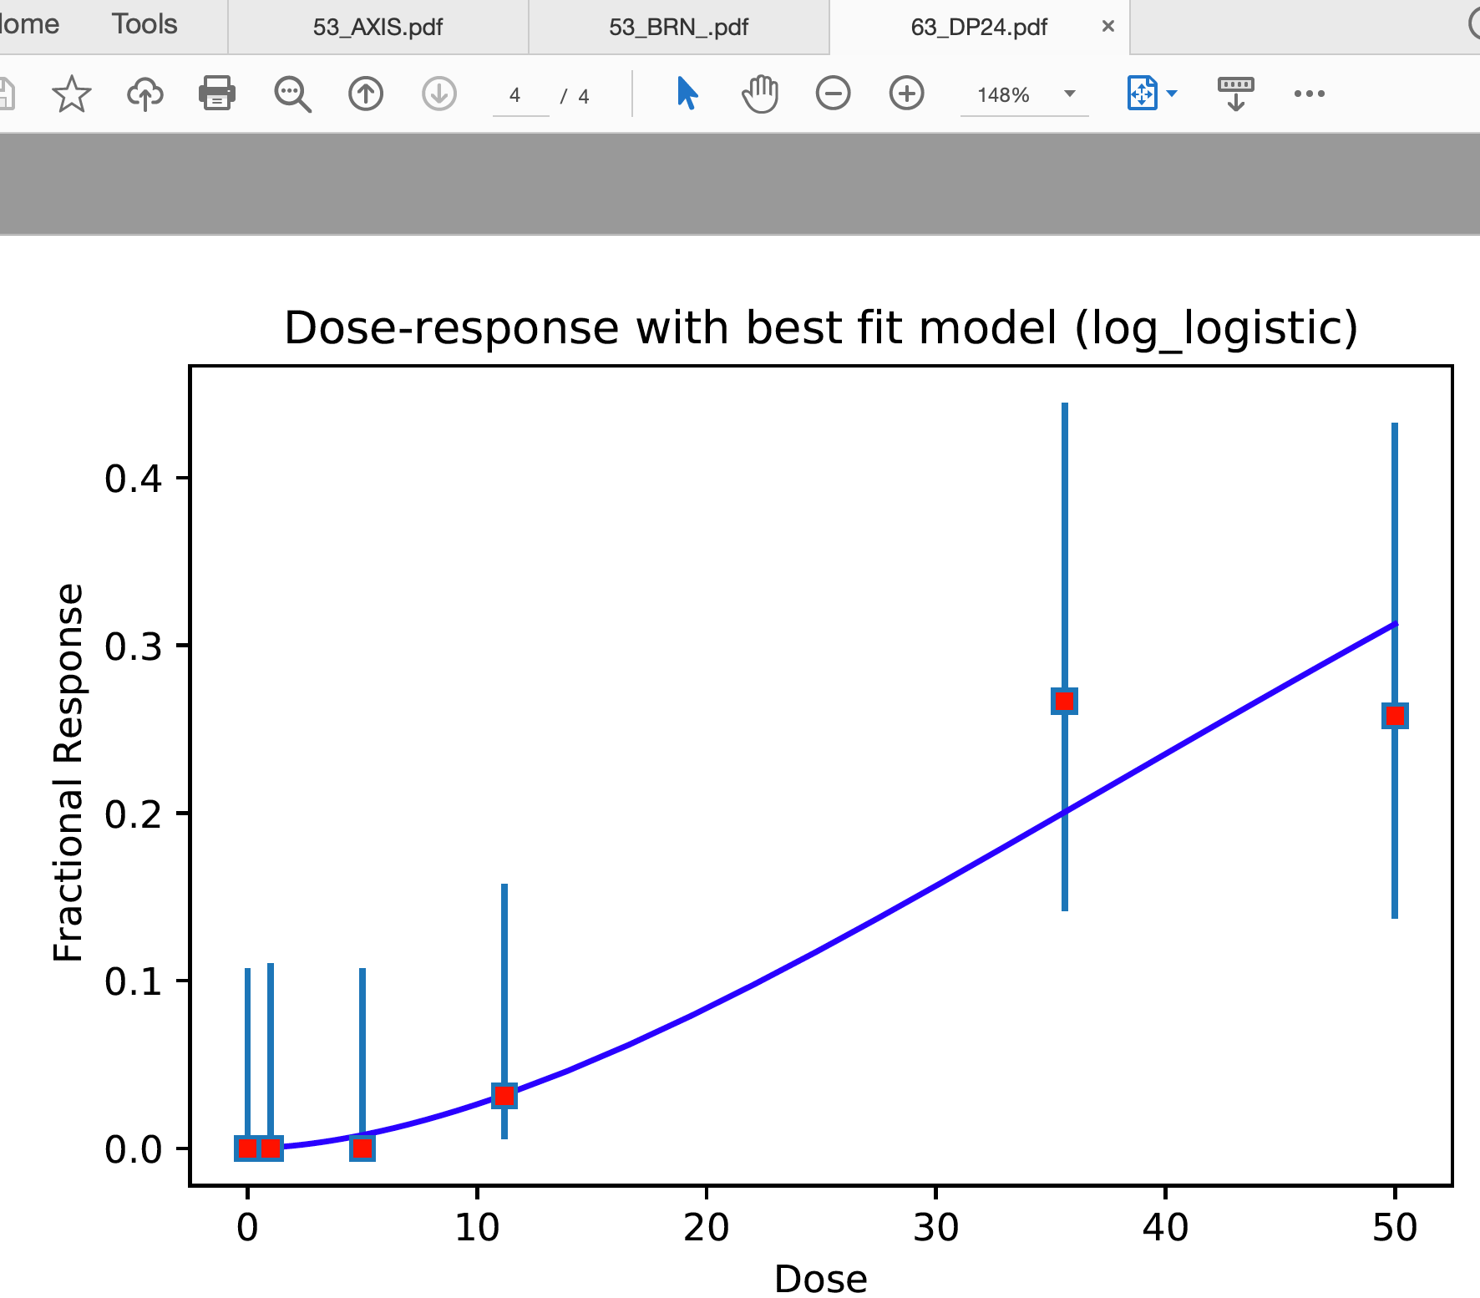
4: Data resolution poor. BMD analysis might be unreliable

Slide 10
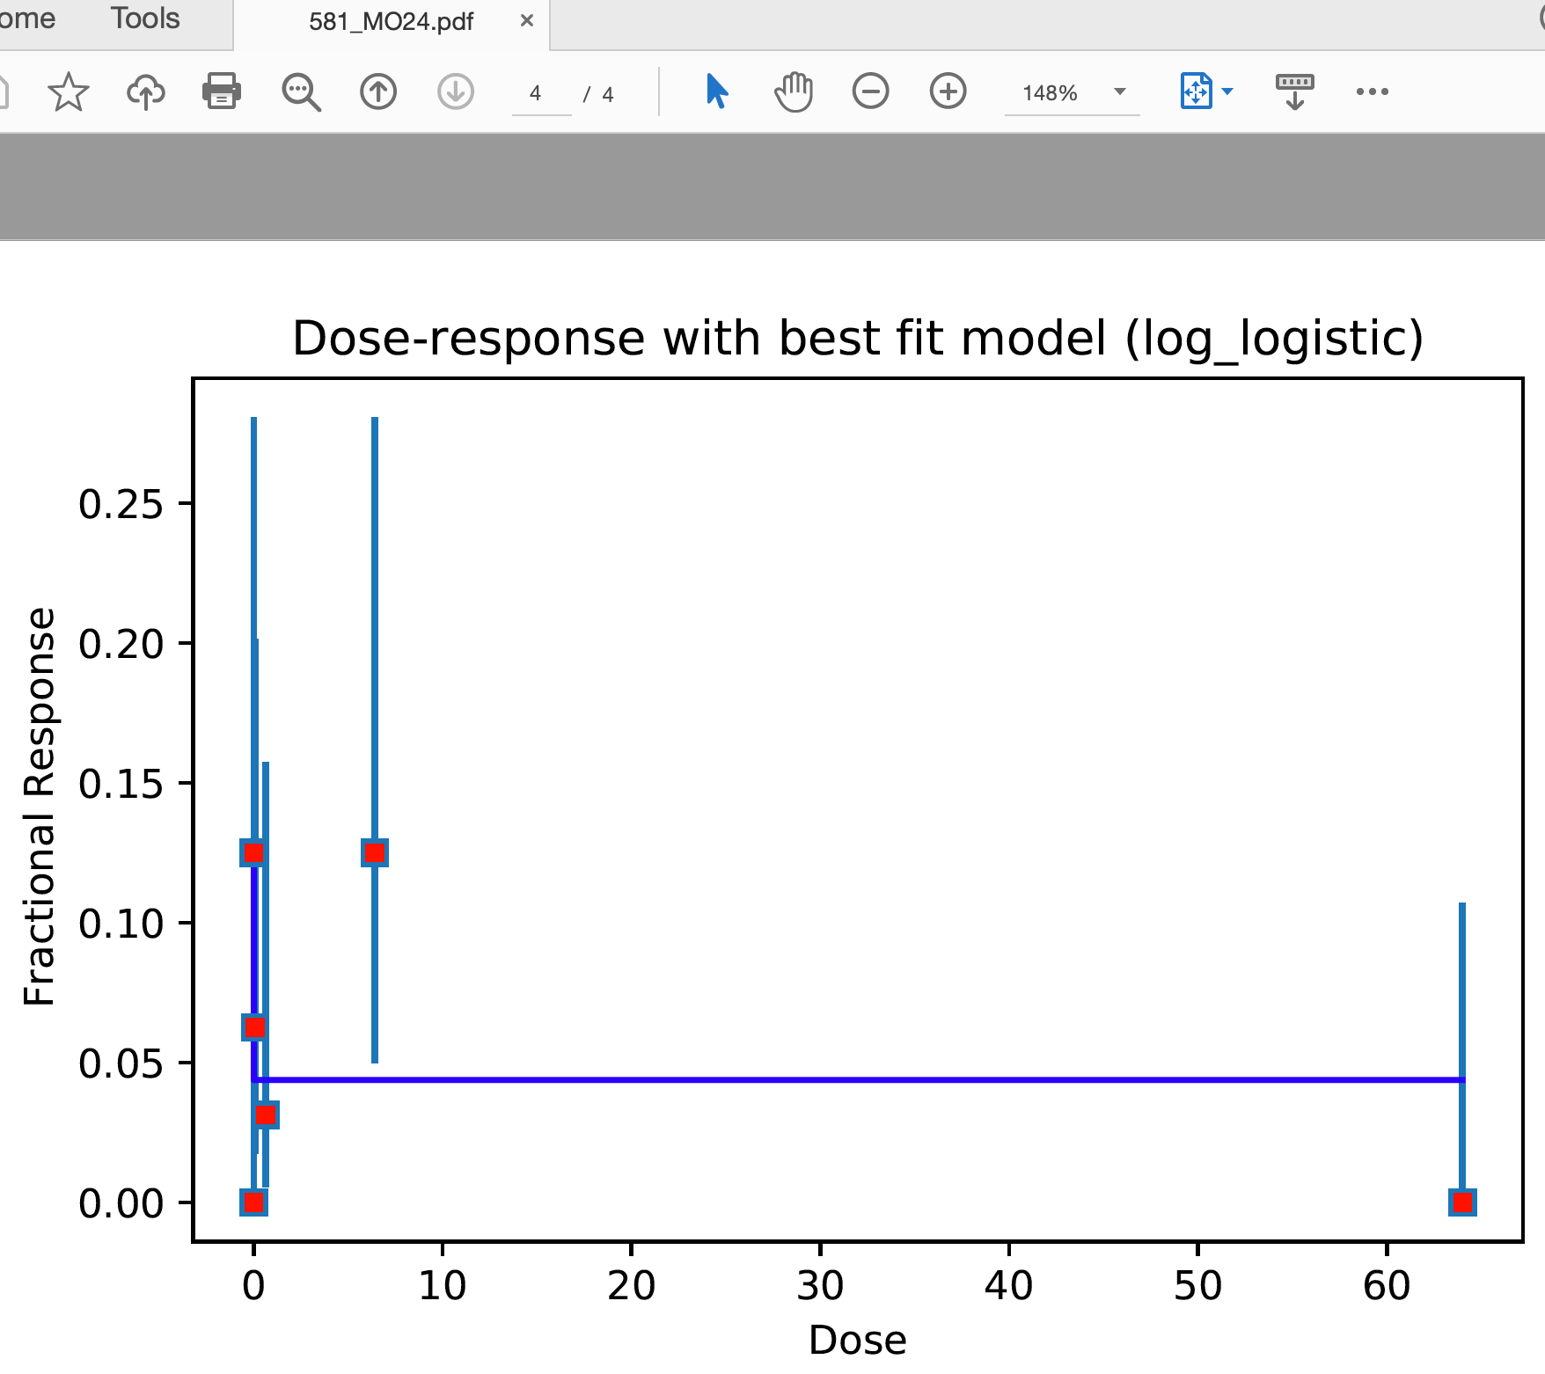
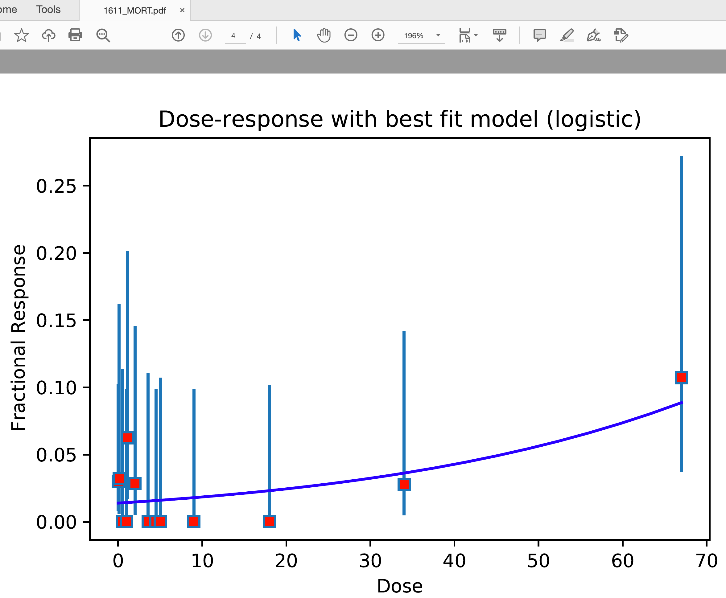
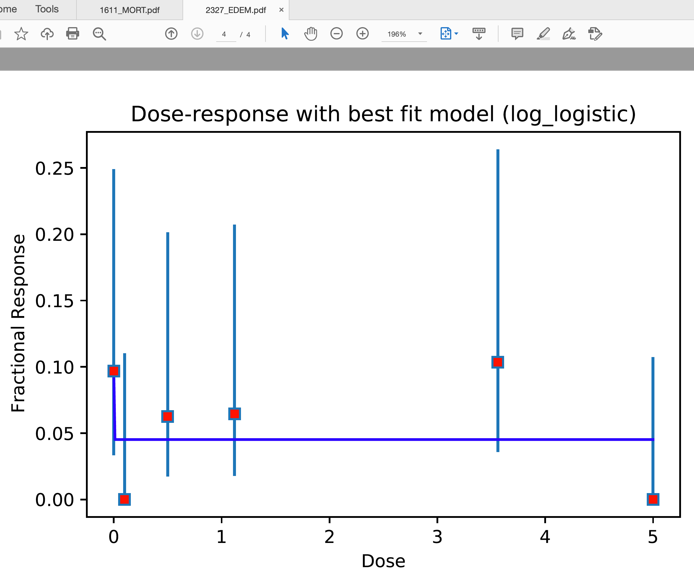
5: Negative correlation detected in dose-response data. Caution advised

Slide 11
As for the data Quality Control requirement, the current criteria considers data unfit for BMD analysis if under any one of the following three cases
There are fewer than 3 dose groups
If the average response for the first two dose groups is higher than the average response at the last two dose groups indicating an overall decreasing trend
If the mean first order differences of responses is 0 indicating a flat response (determined by a t-test with p-value threshold of 0.62, i.e. inside +/- 0.5 sigma)

Slide 12
There are fewer than 3 dose groups
Indeed there are many groups of doses.
For example
number of unique dose values is various as in
len_dose_response_array:[0, 2, 3, 4, 5, 6, 7, 8, 10, 12, 13]
NC24 endpoint
0 1
2 3
3 5
4 12
5 10
6 255
7 1
8 37
10 6
12 5
13 1
chemical.id | plate.id | well | conc | NC24
61 | 14870 | A01 | 5
61 | 14870 | A02 | 3.56
61 | 14870 | A03 | 1.12
61 | 14870 | A04 | 0.5
61 | 14870 | A05 | 0.1 | 0
61 | 14870 | A06 | 0 | 0
61 | 14870 | A07 | 5
61 | 14870 | A08 | 3.56 | 0
61 | 14870 | A09 | 1.12
61 | 14870 | A10 | 0.5 | 0
61 | 14870 | A11 | 0.1
61 | 14870 | A12 | 0 | 0

Slide 13
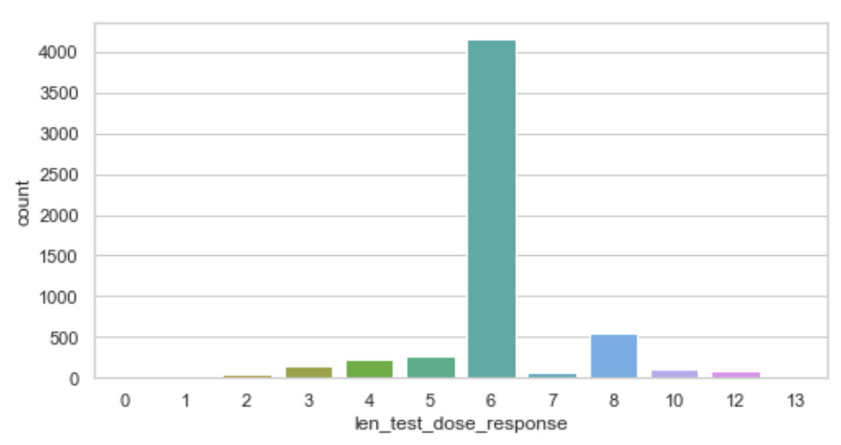
There are fewer than 3 dose groups
When Doonam analyzed 5,712 cases (=336 chemicals x 17 endpoints), 89 cases have < 3 dose groups

Slide 14
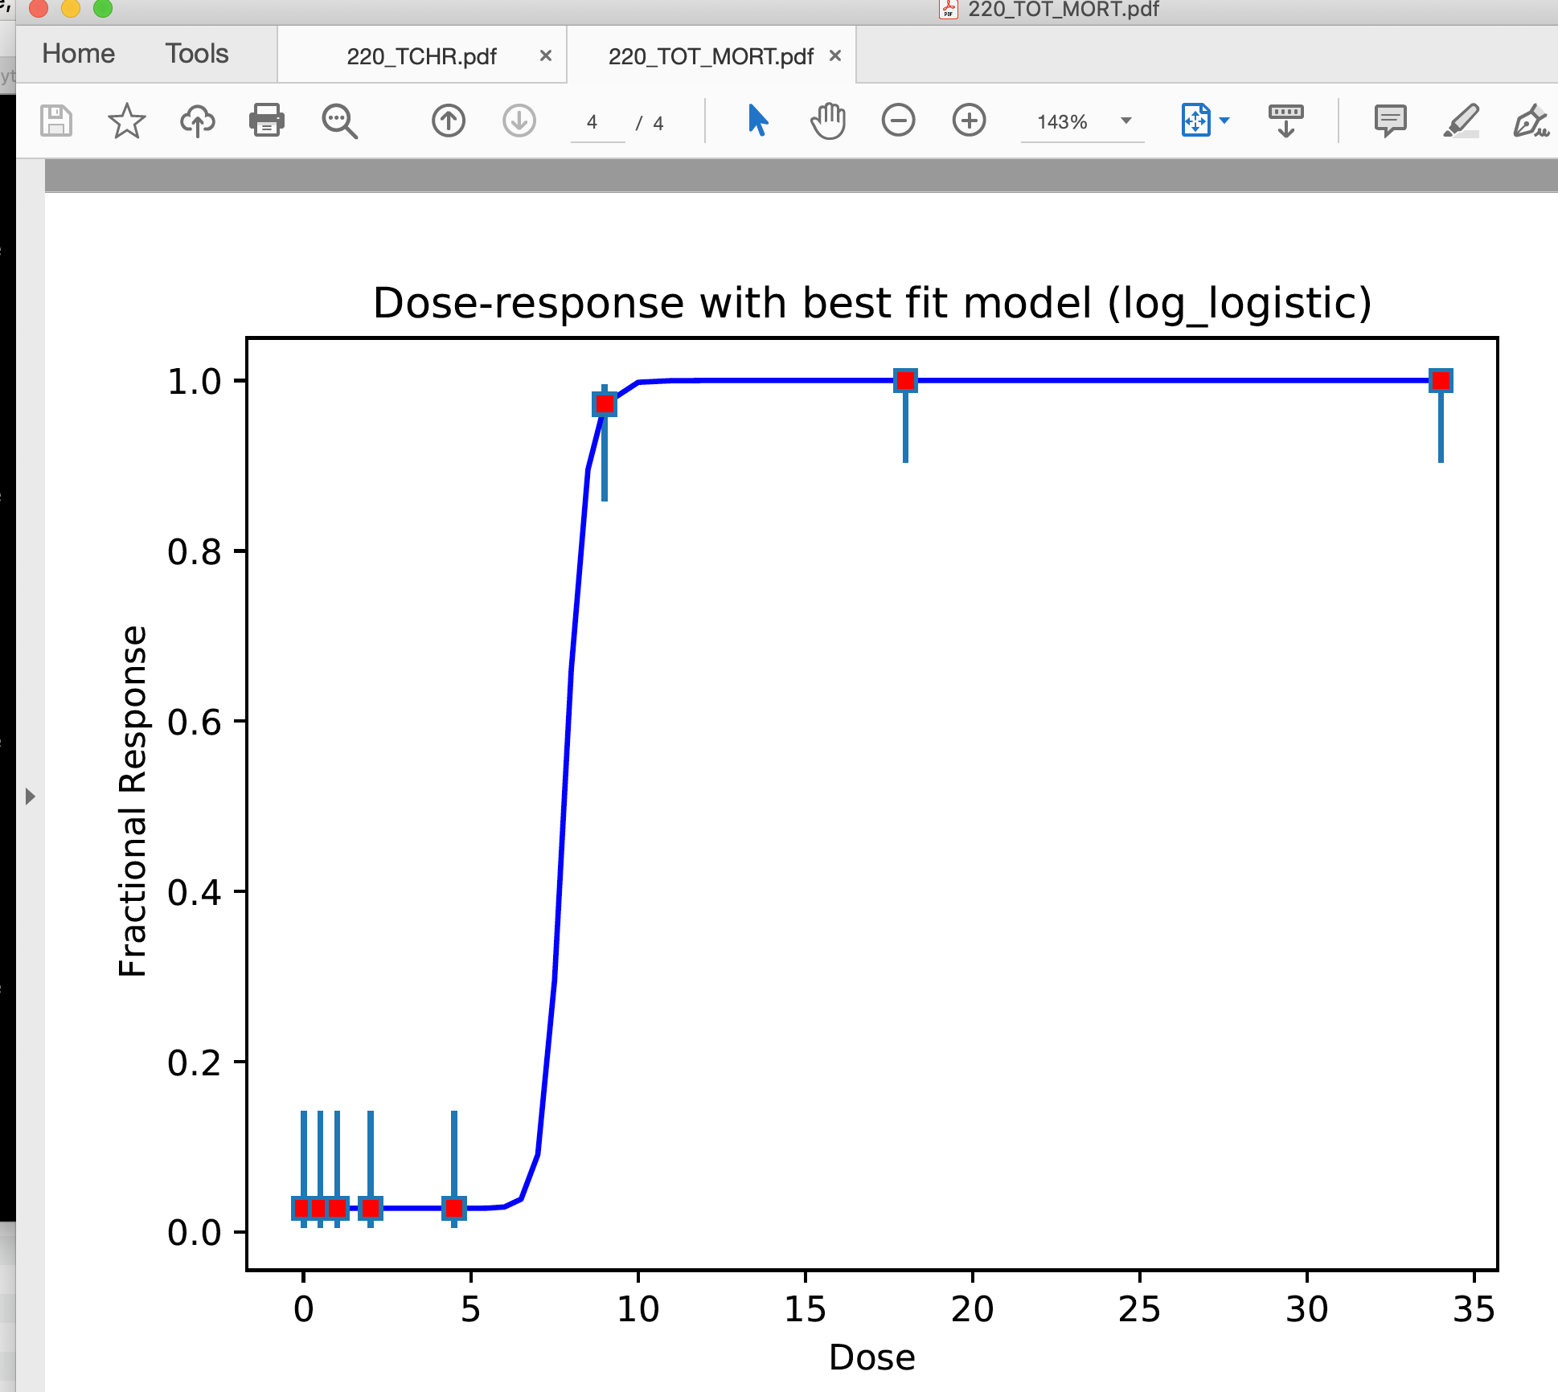
Paritosh’s code can handle all cases of dose groups.
It can handle unusual number of dose groups (e g. 8 dose groups as well
It can handle unusual representation/order of wells
A01 | 34
A02 | 34
A03 | 34
A04 | 34
A05 | 34
A06 | 34
A07 | 34
A08 | 34
A09 | 34
A10 | 34
A11 | 34
A12 | 34
B01 | 18
B02 | 18
B03 | 18
B04 | 18
B05 | 18
B06 | 18
B07 | 18
B08 | 18
B09 | 18
B10 | 18
B11 | 18
B12 | 18
E01 | 64
E02 | 6.4
E03 | 0.64
E04 | 0.064
E05 | 0.0064
E06 | 0

Slide 15
Paritosh’s code reports about all chemicals
phase I and II have 336 chemicals in total.
Paritosh’s code reports about all these chemicals even their heterogenous data and model success differences.

Slide 16
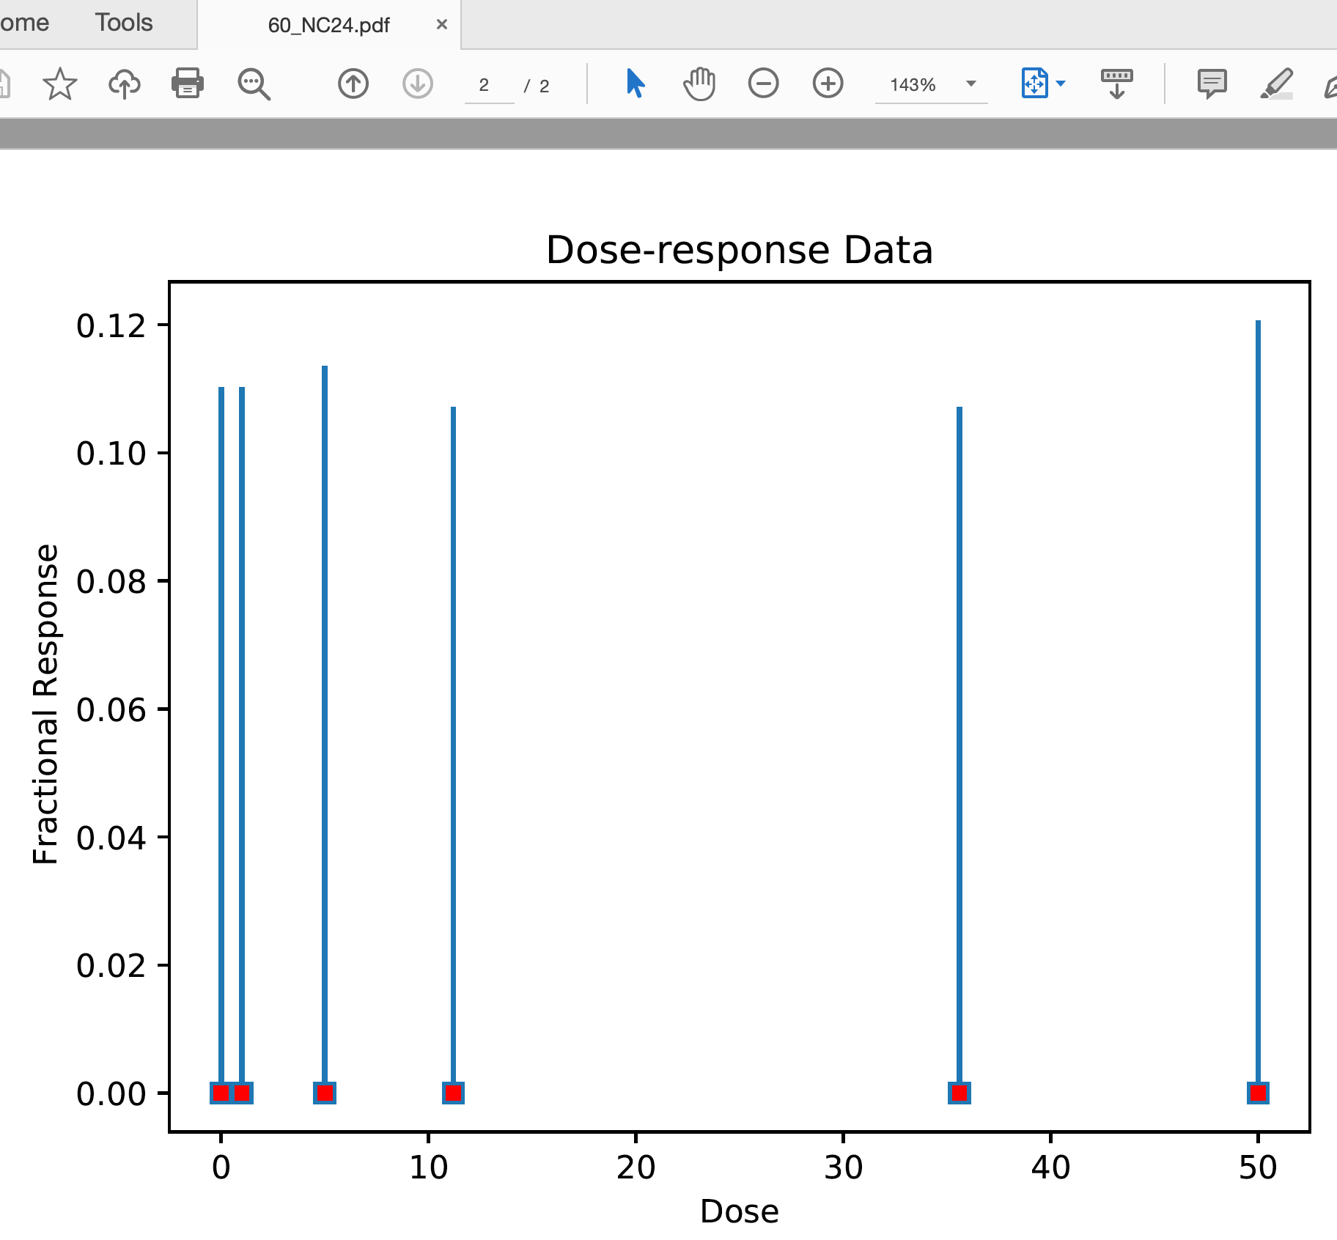
If the mean first order differences of responses is 0 indicating a flat response (determined by a t-test with p-value threshold of 0.62, i.e. inside +/- 0.5 sigma)
Red dot → response in
dose_response_vals
Blue bar → confidence interval
(low, high)

Slide 17
If the mean first order differences of responses is 0 indicating a flat response (determined by a t-test with p-value threshold of 0.62, i.e. inside +/- 0.5 sigma)
After several trials (manually spot-checking dose-response data), Paritosh empirically determined 0.62 p-value as the most reasonable threshold that included some low-quality dose-response data while still excluding extremely poor dose-response data
This value could be adjusted if required. Perhaps the best way to go about this would be to identify several dose-response cases by manually examining dose-response data where the current threshold appears to be too stringent – basically what Paritosh did to determine the threshold

Slide 18
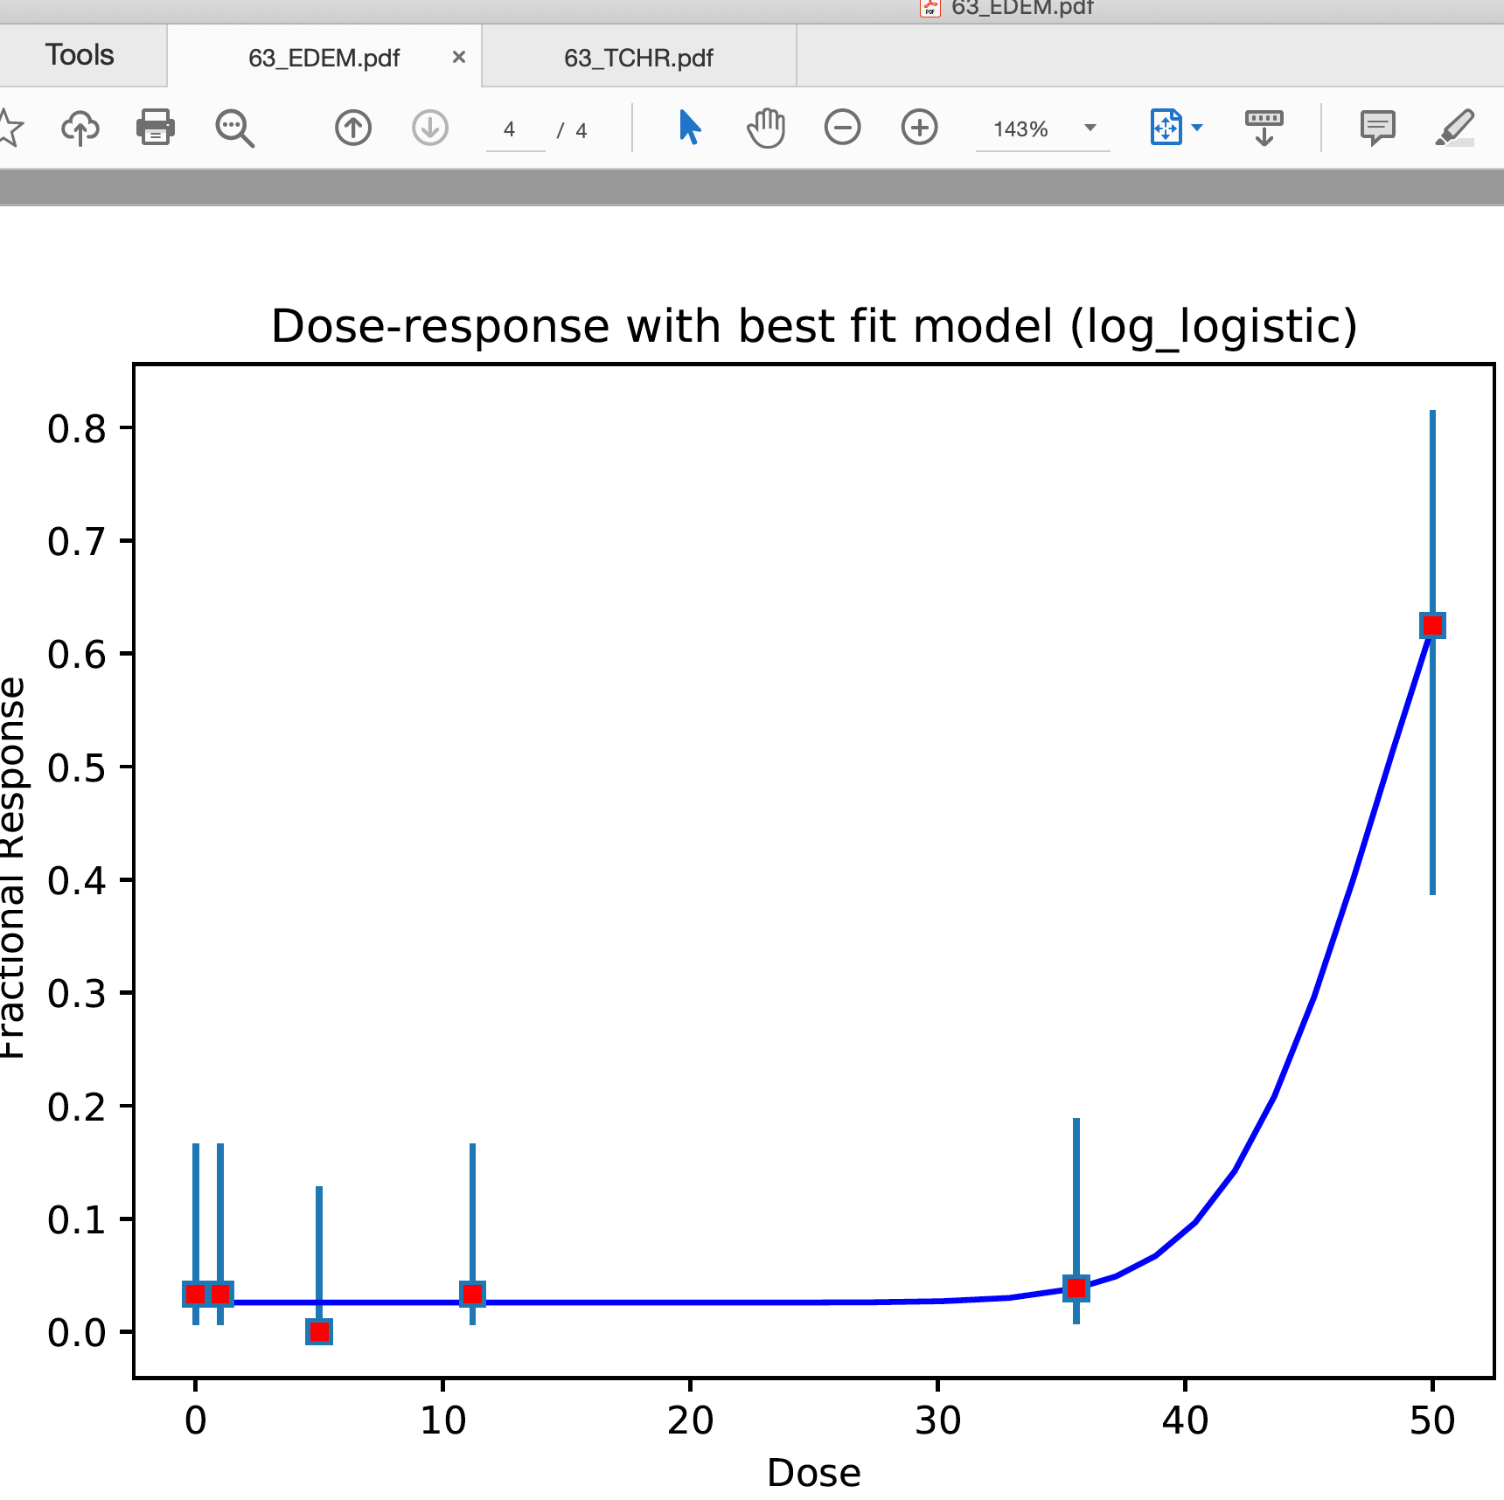
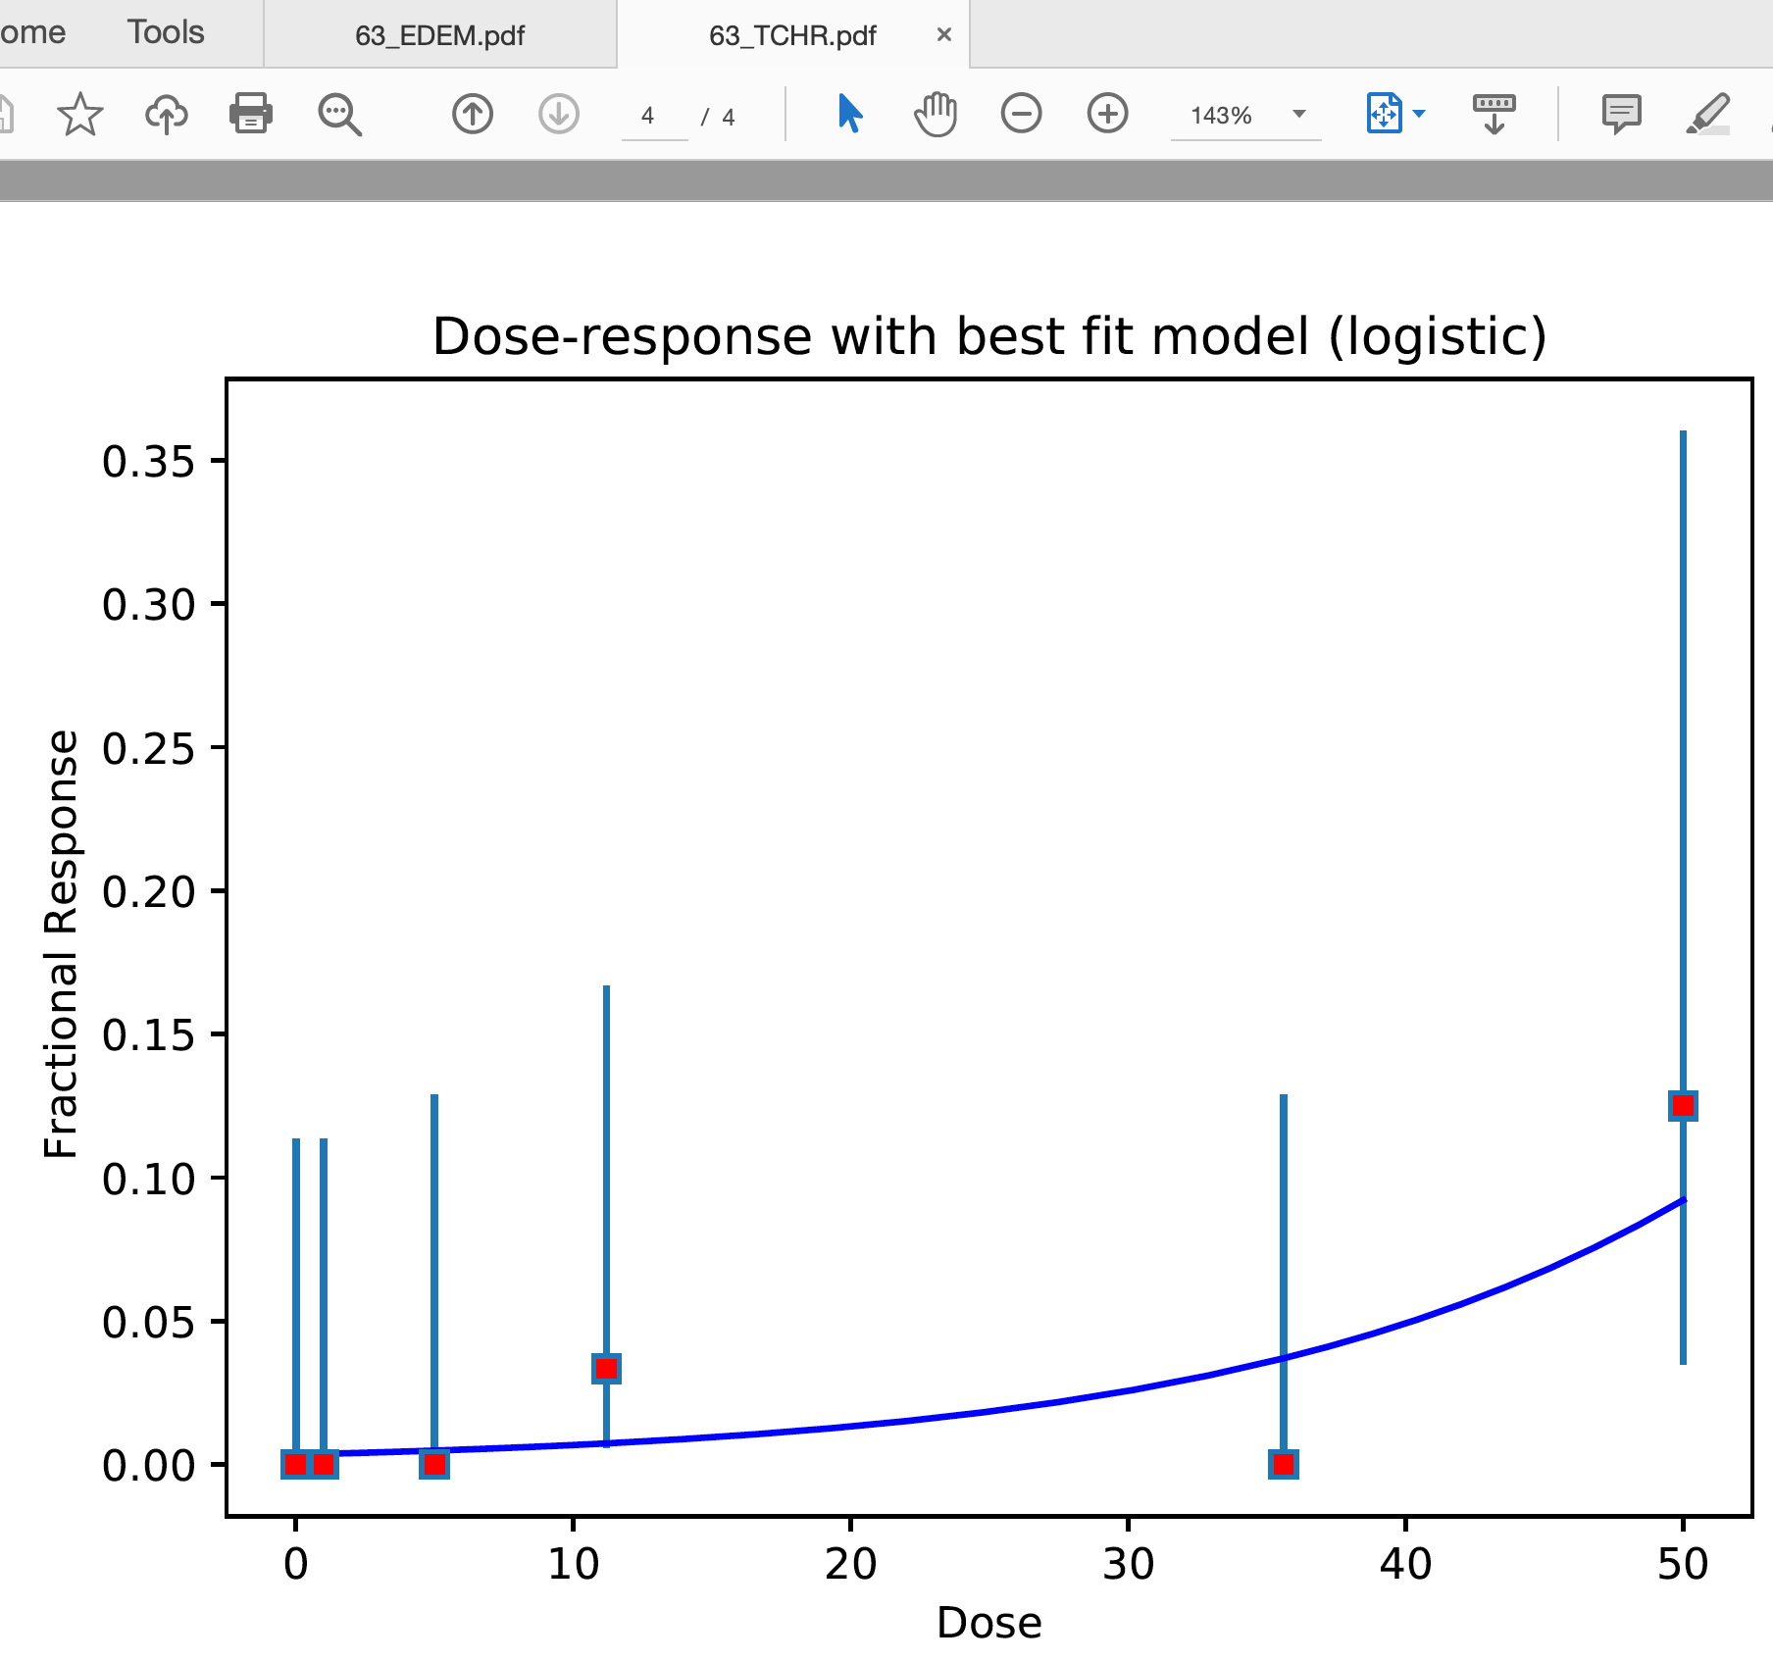
If the mean first order differences of responses is 0 indicating a flat response (determined by a t-test with p-value threshold of 0.62, i.e. inside +/- 0.5 sigma)
Data resolution poor. Caution advised.
Best model found:log_logistic
This current threshold (p-value 0.62)
is lenient (e.g. it includes cases even when there
is only one
Dose where the response is higher than the baseline)
Data resolution poor. Caution advised.
Best model found:logistic

Slide 19
Summary
Doo nam have been co-developing with ~20 other python developers including many berkeley national lab staffs.
Among these, Paritosh’s code is one of the best ones with respect to perfection of dealing in heterogeneous data and organization (even Doo Nam can understand within few hrs).
Of course, there was a hiccup regarding a python dependency. However, it was just scipy versioning issue that even Doo nam may have faced similarly. We all solved the issue now.

